Slide 1
TYPES OF
PRIMITIVE DATA STRUCTURE
POWERED BY GROUP NO 2

Slide 2
1.Integer Primitive Data Structure
Definition and Characteristics
An Integer is a primitive data type used to represent whole numbers (positive or negative).
Characteristics
Values: Can be used with whole numbers (positive or negative).
Operations: Basic operations like addition, subtraction, multiplication, etc., can be performed on it.
Storage: Typically holds a single, simple value
Memory: Usually stored in the stack memory

Slide 3
continue
Mutability: Generally immutable, meaning its value cannot be changed once created (though its variable can be assigned a new value)⁷.
Algorithm Concept
Since an integer is a single, simple value, an algorithm for its operation usually involves basic arithmetic. A simple example is an algorithm for Adding Two Integers.
Example 01
    Algorithm: Adding Two Integers by using pseudo code
Start.
Input: Get the first integer value, A.

Slide 4
continue
3. Input: Get the second integer value, B.
4. Process: Calculate the sum, S = A + B.
5. Output: Display the result, S.
6. Stop.
C Programming Example
Here is a C code snippet that implements the algorithm for adding two integers, as requested for the assignment

Slide 5
continue
#include <stdio.h>
int main() {
int A, B, S; // Declare integer variables
// Input values
printf("Enter the first integer (A): ");
scanf("%d", &A);
printf("Enter the second integer (B): ");
scanf("%d", &B);
// Step 4: Process - Calculate the sum

Slide 6
continue
S = A + B;
// Step 5: Output the result
printf("The sum of %d and %d is: %d\n", A, B, S);
// Step 6: Stop
return 0;
}

Slide 7
Example 02
A simple algorithm demonstrating the Integer data structure is to Find the Area of a Rectangle, which involves multiplication.
Algorithm: Find the Area of a Rectangle
Start.
Input: Get the length, L, as an integer.
Input: Get the width, W, as an integer.
Process: Calculate the area, A, by multiplying the length and width
(A = L * W).
5. Output: Display the result, A.
6. Stop.

Slide 8
Continue
C Programming Example
Here is a simple C code snippet that implements the algorithm to calculate the area using the int data type.
#include <stdio.h>
int main() {
int length, width, area; // Declare integer variable
printf(" Area of a Rectangle Calculator \n");
// 2. Input: Get length
printf("Enter the length:");
scanf("%d", &length);

Slide 9
continue
// 3. Input: Get width
printf("Enter the width: ");
scanf("%d", &width);
// 4. Process: Calculate the area
area = length * width;
// 5. Output: Display the result
printf("\nLength: %d\n", length);
printf("Width: %d\n", width);
printf("The Area of the rectangle is: %d\n", area);
return 0;
}

Slide 10
2.Float Primitive Data Structure
Definition and Characteristics
A Float (or floating-point) is a primitive data structure used to represent numbers with decimals.
characteristics
Values: Represents numbers with fractional parts, like 3.14 or -0.005.
Storage: Holds a single, simple value.
Memory: Usually stored in the stack memory.
Operations: Used for arithmetic operations that require high precision or may result in a non-whole number (division, square root, etc.).

Slide 11
continue
Algorithm Concept (example 01)
A common use for floating-point numbers is calculating averages, which typically involves division. Let's create an algorithm to Calculate the Average of Three Test Scores.
Algorithm: Calculate the Average of Three Scores
Start.
Input: Get three test scores, S1, S2, and S3, as floats.
Process (Sum): Calculate the total sum, T = S1 + S2 + S3.
Process (Average): Calculate the average, A, by dividing the total sum by 3. A = T / 3. (Since the result might be a decimal, A must be a float.)
Output: Display the calculated average, A.
Stop.

Slide 12
continue
C Programming Example
This C code uses the float data type for the division result to maintain precision.
#include <stdio.h>
int main() {
float S1, S2, S3; // Test scores can be float to handle decimals
float Total, Average; // Total sum and average
// Step 2: Input three scores
printf("Enter first score (S1): ");
scanf("%f", &S1);
printf("Enter second score (S2): ");
scanf("%f", &S2);
printf("Enter third score (S3): ");
scanf("%f", &S3);

Slide 13
continue
// Step 3: Process (Sum)
Total = S1 + S2 + S3;
// Step 4: Process (Average)
Average= Total / 3;
// Step 5: Output the result
printf("\nScores: %.2f, %.2f, %.2f\n", S1, S2, S3);
printf("Total Sum (T): %.2f\n", Total);
printf("Average (A): %.2f\n", Average);
// Step 6: Stop
return 0;
}

Slide 14
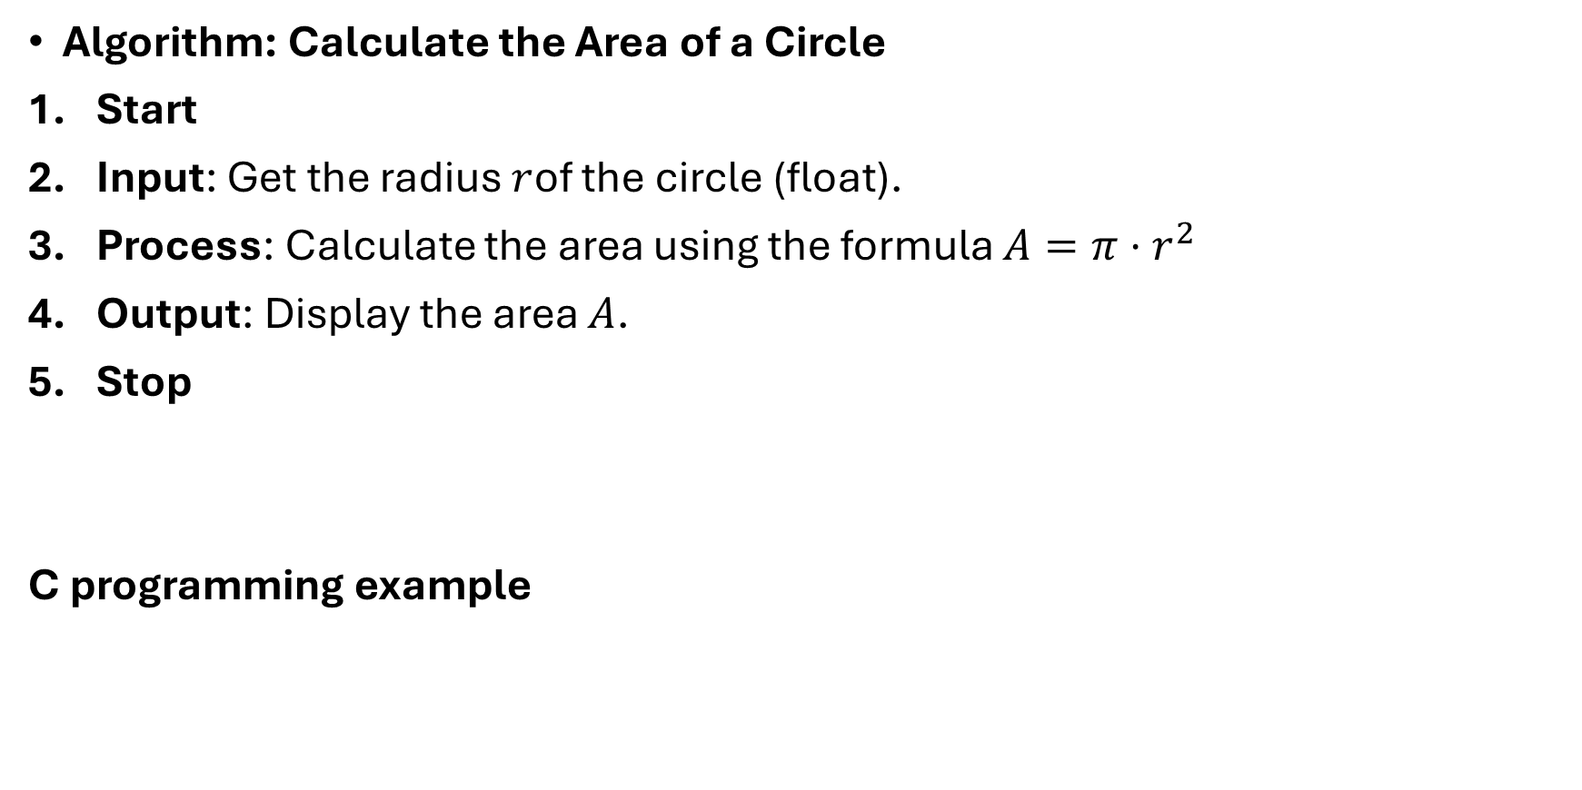
Example 02
Algorithm: Calculate the Area of a Circle
Start
Input: Get the radius $r$of the circle (float).
Process: Calculate the area using the formula $A=π⋅r^{2}$
Output: Display the area $A$.
Stop
C programming example

Slide 15
continue
#include <stdio.h>
#define PI 3.14159 // Define constant value for π
int main() {
float r, A; // Radius and Area as float
// Step 2: Input radius
printf("Enter the radius of the circle: ");
scanf("%f", &r);
// Step 3: Process - Calculate area
A = PI * r * r;
// Step 4: Output result
printf("Radius: %.2f\n", r);
printf("Area of the circle: %.2f\n", A);
return 0; }

Slide 16
3.Boolean Primitive Data Structure
Definition and Characteristics
A Boolean is a primitive data structure that represents a value of either true or false.
charateristics
Values: Can only be true or false.
Purpose: Fundamental for conditional execution and logical operations.
Storage: Stores a single, simple value.
Memory: Stored in the stack memory.

Slide 17
continue
Algorithm Concept (example 01)
An algorithm demonstrating the Boolean type is to Determine Voting Eligibility, which involves checking multiple conditions using logical operators.
Algorithm: Determine Voting Eligibility
Start.
Input: Get the user's age, A, as an integer.
Process (Check Age): Evaluate if the age A is 18 or greater. Assign the result (True/False) to the Boolean variable E. (E = A ≥ 18)
Condition (Output):
  If E is True, display a message: "The person is eligible to vote."
  If E is False, display a message: "The person is NOT eligible to vote."
Stop.

Slide 18
continue
C Programming Example
This code uses the bool data type (by including stdbool.h) to store the result of a comparison.
#include <stdio.h>
#include <stdbool.h> // For using Boolean type in C
int main() {
int A; // User's age
bool E; // Eligibility status (True/False)
// Step 2: Input age
printf("Enter your age: ");
scanf("%d", &A);

Slide 19
continue
// Step 3: Process (Check Age)
E = (A >= 18);
// Step 4: Condition (Output)
if (E) {
printf("The person is eligible to vote.\n");
} else {
printf("The person is NOT eligible to vote.\n");
}
// Step 5: Stop
return 0;
}

Slide 20
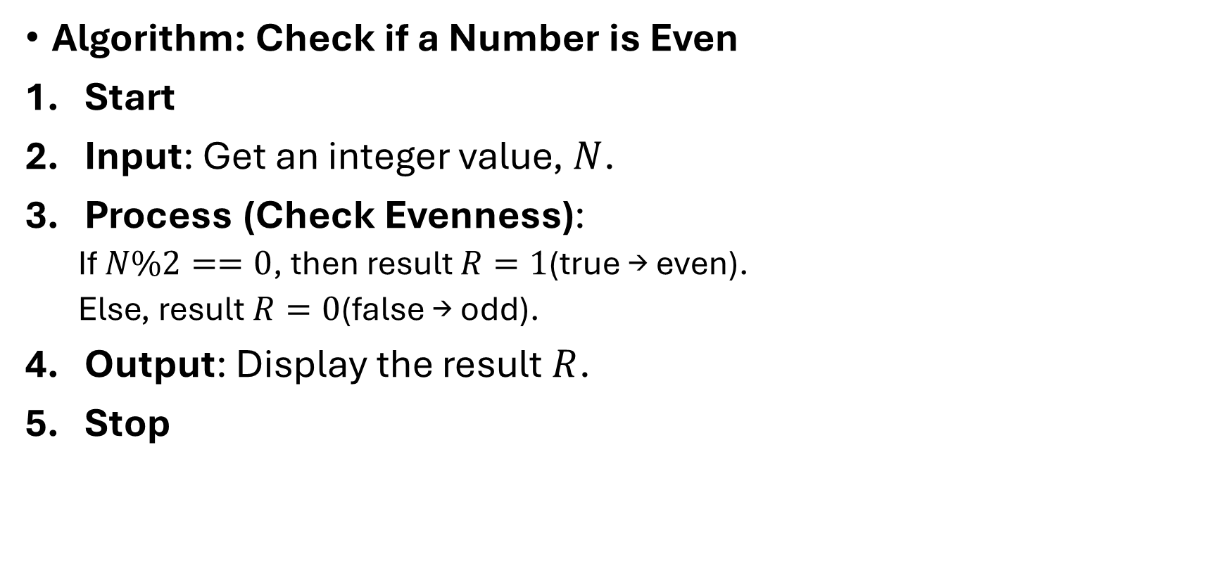
Example 02
Algorithm: Check if a Number is Even
Start
Input: Get an integer value, $N$.
Process (Check Evenness):
  If $N\%2==0$, then result $R=1$(true → even).
  Else, result $R=0$(false → odd).
Output: Display the result $R$.
Stop

Slide 21
continue
C Program Example
#include <stdio.h>
#include <stdbool.h> // For Boolean type
int main() {
int N; // Number to check
bool R; // Result: true (1) or false (0)
// Step 2: Input
printf("Enter an integer: ");
scanf("%d", &N);
// Step 3: Process (Check Evenness)
R = (N % 2 == 0);

Slide 22
continue
// Step 4: Output
printf("Result: %d\n", R);
// Will print 1 if true (even), 0 if false (odd)
// Step 5: Stop
return 0;
}

Slide 23
4. Character Primitive Data Structure
Definition and Characteristics
A Character data structure represents individual characters, usually stored as a single byte.
characteristics
Values: Individual letters, digits, symbols, or whitespace.
Storage: Typically holds a single value.
Memory: Stored in the stack memory.
Operations: Can use basic operations, such as comparisons to determine alphabetical order or case (e.g., uppercase vs. lowercase).

Slide 24
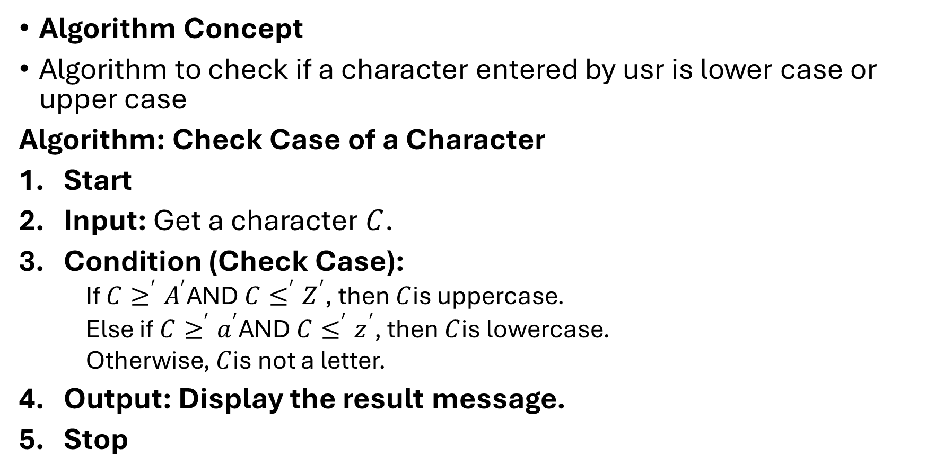
continue
Algorithm Concept
Algorithm to check if a character entered by usr is lower case or upper case
Algorithm: Check Case of a Character
Start
Input: Get a character $C$.
Condition (Check Case):
  If $C≥^{′}A^{′}$AND $C≤^{′}Z^{′}$, then $C$is uppercase.
  Else if $C≥^{′}a^{′}$AND $C≤^{′}z^{′}$, then $C$is lowercase.
  Otherwise, $C$is not a letter.
Output: Display the result message.
Stop

Slide 25
continue
C Programming Example
#include <stdio.h>
int main() {
char C;
// Step 2: Input
printf("Enter a single character: ");
scanf(" %c", &C);
// Step 3: Condition (Check Case)
if (C >= 'A' && C <= 'Z') {
printf("%c is an uppercase letter.\n", C);
} else if (C >= 'a' && C <= 'z') {
printf("%c is a lowercase letter.\n", C);
} else {
printf("%c is not a letter.\n", C);
} return 0; }

Slide 26
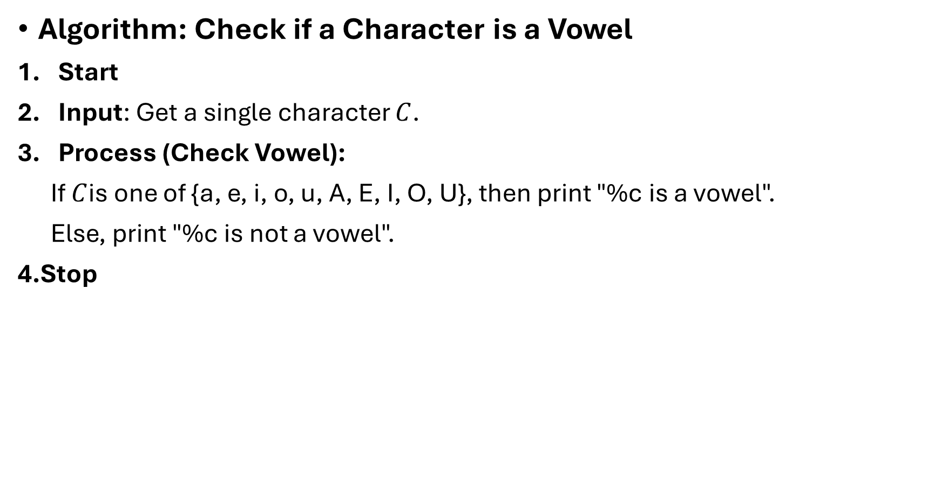
Example 02
Algorithm: Check if a Character is a Vowel
Start
Input: Get a single character $C$.
Process (Check Vowel):
If $C$is one of {a, e, i, o, u, A, E, I, O, U}, then print "%c is a vowel".
Else, print "%c is not a vowel".
4.Stop

Slide 27
continue
C programming example
#include <stdio.h>
int main() {
char C; // Character input
// Step 2: Input
printf("Enter a single character: ");
scanf(“ %c\n", &C);

Slide 28
continue
// Step 3: Process (Check Vowel)
if (C == 'a' || C == 'e' || C == 'i' || C == 'o' || C == 'u' ||
C == 'A' || C == 'E' || C == 'I' || C == 'O' || C == 'U') {
printf("%c is a vowel.\n", C);
} else {
printf("%c is not a vowel.\n", C);
}
// Step 4: Stop
return 0; }

Slide 29
*******************THE END*******************

